Slide 1
CMSC204
V(StateGraph) = {Oregon, Alaska, Texas, Hawaii, Vermont, NewYork, California}
E(StateGraph) = {(Alaska, Oregon), (Hawaii, Alaska), (Hawaii, Texas), (Texas, Hawaii), (Hawaii, California), (Hawaii, New York), (Texas, Vermont), (Vermont, California), (Vermont, Alaska)}
1. Draw the StateGraph
Oregon
New York
Alaska
Vermont
Hawaii
Texas
California

Slide 2
a. Show the adjacency matrix that would describe the edges in the graph. Store the vertices in alphabetical order
States | Alaska | California | Hawaii | New York | Oregon | Texas | Vermont
Alaska | 0 | 0 | 0 | 0 | 1 | 0 | 0
California | 0 | 0 | 0 | 0 | 0 | 0 | 0
Hawaii | 1 | 1 | 0 | 1 | 0 | 1 | 0
New York | 0 | 0 | 0 | 0 | 0 | 0 | 0
Oregon | 0 | 0 | 0 | 0 | 0 | 0 | 0
Texas | 0 | 0 | 1 | 0 | 0 | 0 | 1
Vermont | 1 | 1 | 0 | 0 | 0 | 0 | 0
Adjacency Matrix for Directed Graph
3. b. Show the adjacency lists
that would describe the edges in the graph
Alaska - Oregon
Hawaii - Alaska
Hawaii - California
Hawaii - New York
Hawaii - Texas
Texas - Hawaii
Texas - Vermont
Vermont - Alaska
Vermont - California

Slide 3
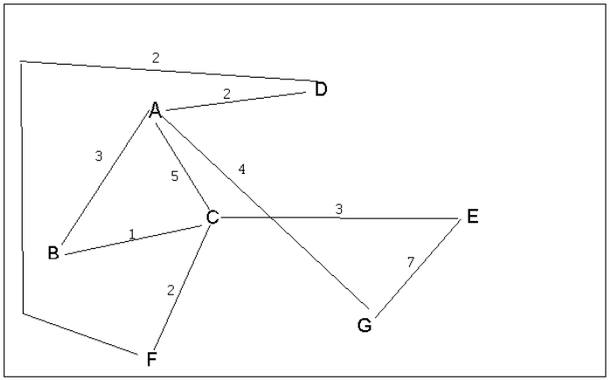
4 a. Which of the following lists the graph nodes in depth first order beginning with E?
A) E, G, F, C, D, B, A
B) G, A, E, C, B, F, D
C) E, G, A, D, F, C, B
D) E, C, F, B, A, D, G
4 b. Which of the following lists the graph nodes in breadth first order beginning at F?
A) F, C, D, A, B, E, G
B) F, D, C, A, B, C, G
C) F, C, D, B, G, A, E
D) a, b, and c are all breadth first traversals

Slide 4
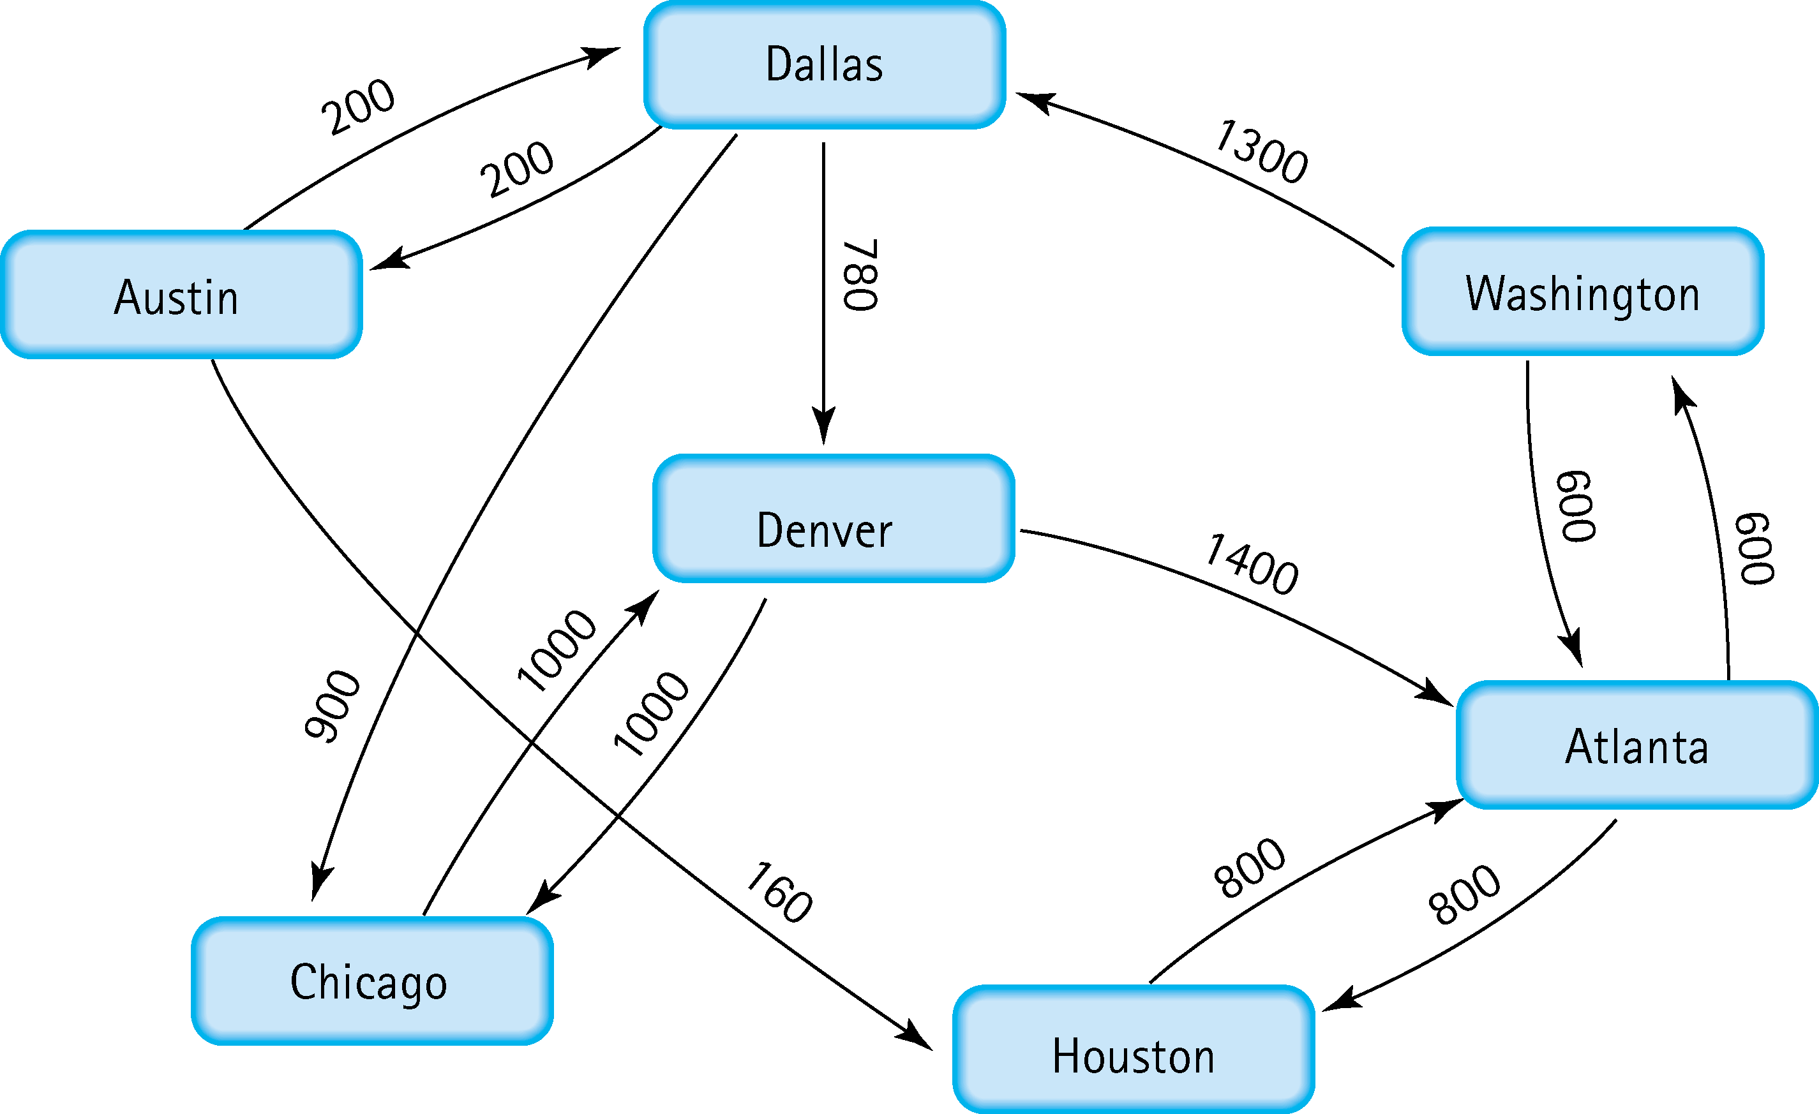
5. Find the shortest distance from Atlanta to every other city
Atlanta - Washington | 600
Atlanta - Dallas | 1900
Atlanta - Denver | 2680
Atlanta - Austin | 2100
Atlanta - Huston | 800
Atlanta - Chicago | 2800

Slide 5
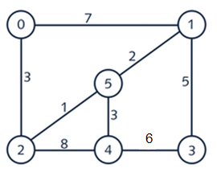
6. Find the minimal spanning tree using Prim’s algorithm. Use
0 as the source vertex . Show the steps.
0
1
5
2
4
3
0
1
0
1
0
1
5
5
5
2
4
3
2
4
3
2
4
3
0
1
0
1
0
1
5
5
5
2
4
3
2
4
3
2
4
3

Slide 6
7. Find the minimal spanning tree using Kruskal’s algorithm.
Show the weights in order and the steps.
Edge | Weight
2 – 5 | 1
1 – 5 | 2
0 – 2 | 3
4 – 5 | 3
1 – 3 | 5
3 – 4 | 6
0 – 1 | 7
2 – 4 | 8
0
1
Edge | Weight
2 – 5 | 1
1 – 5 | 2
0 – 2 | 3
4 – 5 | 3
1 – 3 | 5
3 – 4 | 6
0 – 1 | 7
2 – 4 | 8
5
2
4
3
V= {2,5}
0
1
Edge | Weight
2 – 5 | 1
1 – 5 | 2
0 – 2 | 3
4 – 5 | 3
1 – 3 | 5
3 – 4 | 6
0 – 1 | 7
2 – 4 | 8
5
2
4
3
V= {1,2,5}

Slide 7
0
1
Edge | Weight
2 – 5 | 1
1 – 5 | 2
0 – 2 | 3
4 – 5 | 3
1 – 3 | 5
3 – 4 | 6
0 – 1 | 7
2 – 4 | 8
5
2
4
3
V= {0,1,2,5}
0
1
Edge | Weight
2 – 5 | 1
1 – 5 | 2
0 – 2 | 3
4 – 5 | 3
1 – 3 | 5
3 – 4 | 6
0 – 1 | 7
2 – 4 | 8
5
2
4
3
V= {0, 1, 2, 4, 5}
0
1
Edge | Weight
2 – 5 | 1
1 – 5 | 2
0 – 2 | 3
4 – 5 | 3
1 – 3 | 5
3 – 4 | 6
0 – 1 | 7
2 – 4 | 8
5
2
4
3
V= {0, 1, 2, 3, 4, 5}
0
1
Edge | Weight
2 – 5 | 1
1 – 5 | 2
0 – 2 | 3
4 – 5 | 3
1 – 3 | 5
3 – 4 | 6
0 – 1 | 7
2 – 4 | 8
5
2
4
3
V= {0, 1, 2, 3, 4, 5}

Slide 8
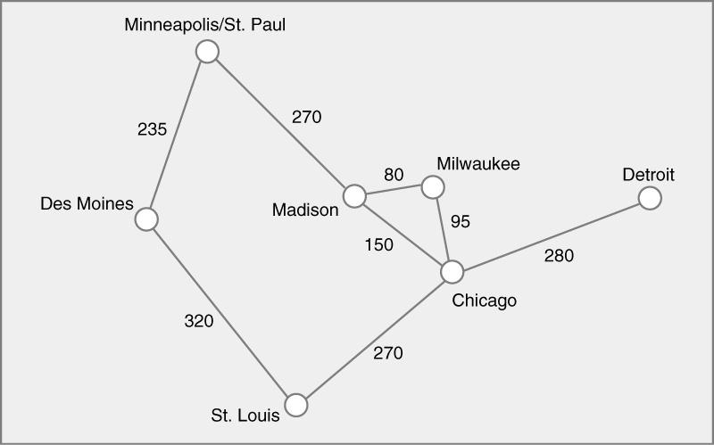






8. Find the minimal spanning tree using the algorithm you prefer. Use
Minneapolis/St. Paul as the source vertex

Slide 9
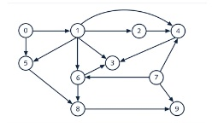
9. List the nodes of the graph in a breadth first topological ordering. Show the
steps using arrays predCount, topologicalOrder and a queue

Slide 10

10. List the nodes of the graph in a breadth first topological ordering.

